Slide 1
Virtual Machine on AWS Console using windows OS

Slide 2
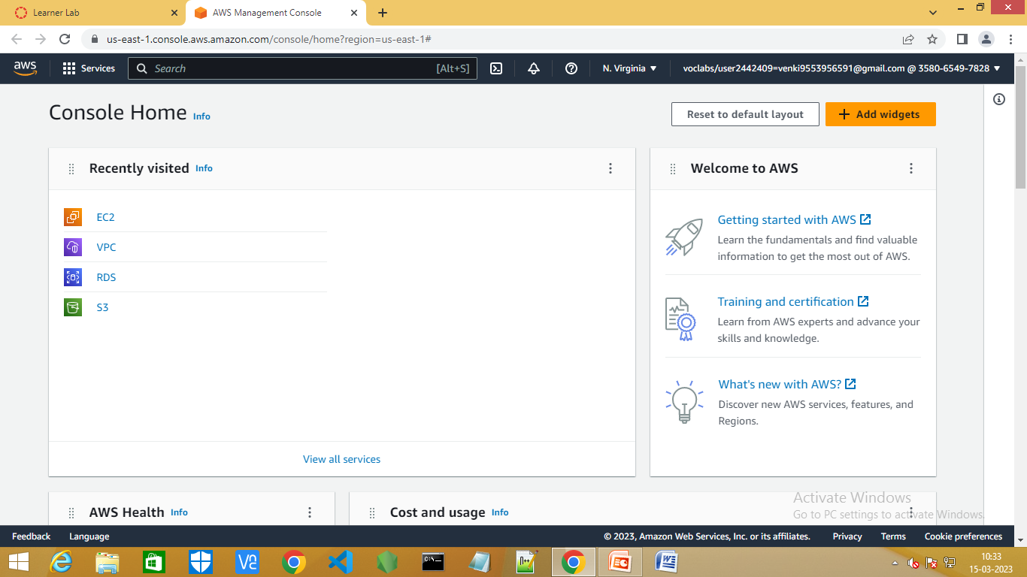
Step1:Go to the AWS Console.

Slide 3
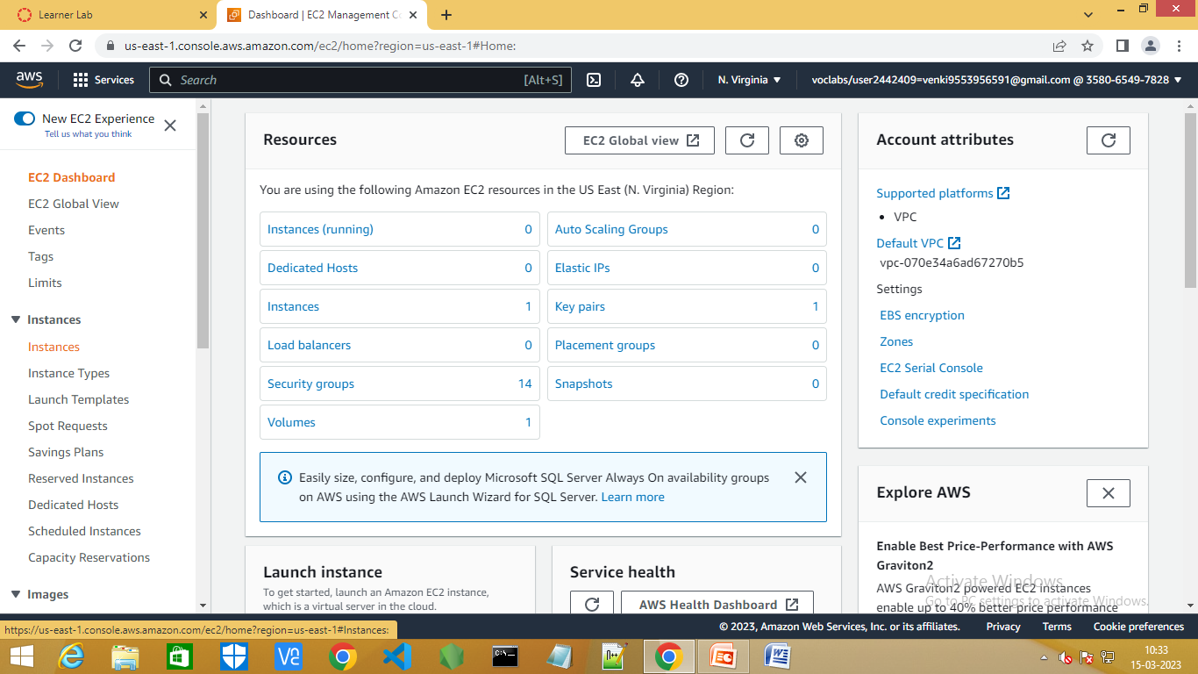
Step2:Go to EC2 dashboard and select instances.

Slide 4
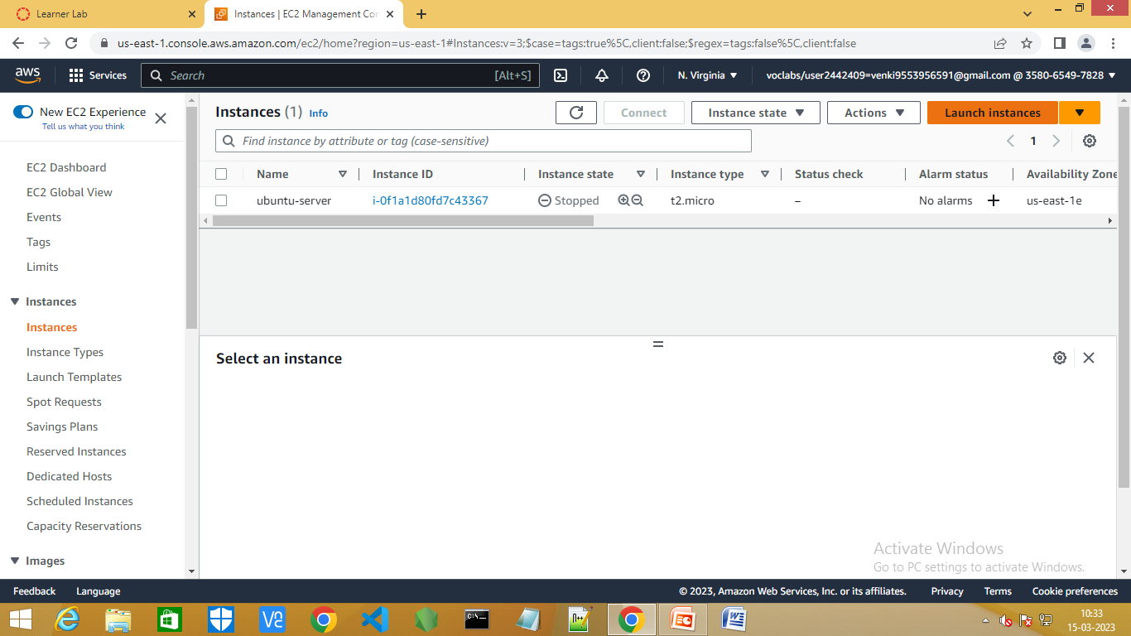
Step3:Click on launch instances.

Slide 5
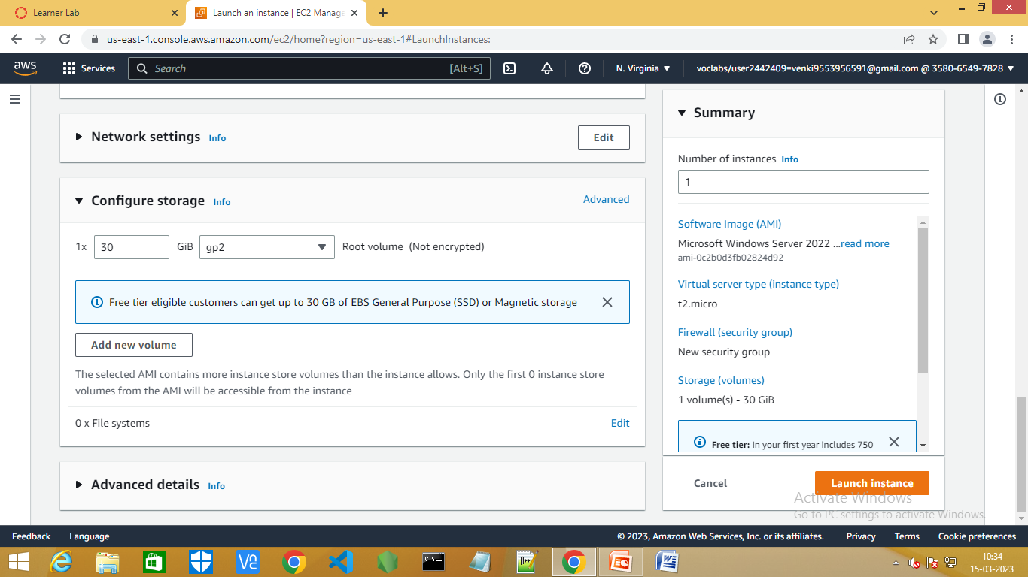
Step4:Fill the contents as shown below.

Slide 6
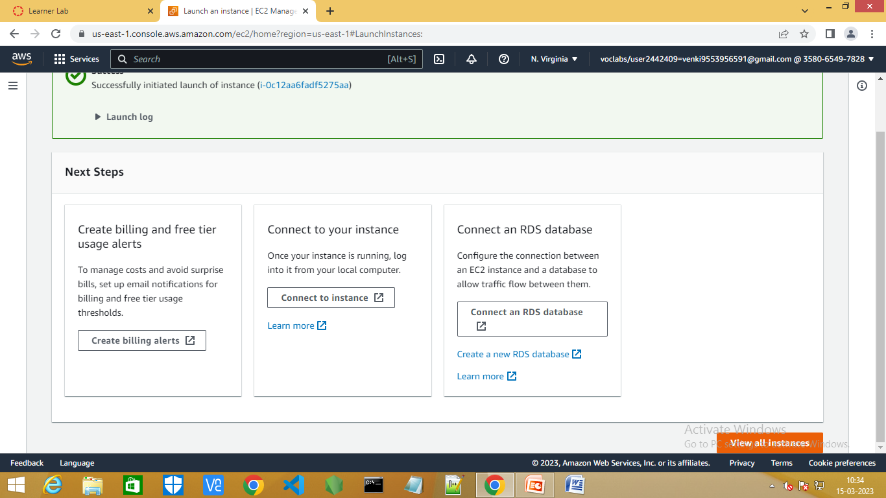
Step5:Now select view all instances.

Slide 7
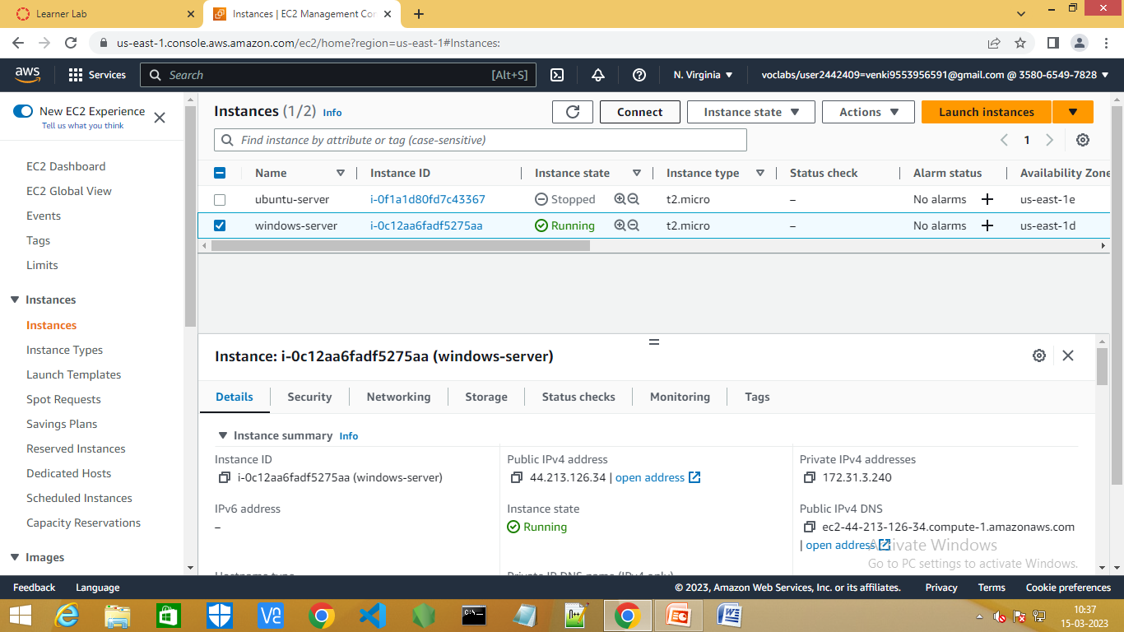
Step6:Now select windows-serever instance and click on connect.

Slide 8
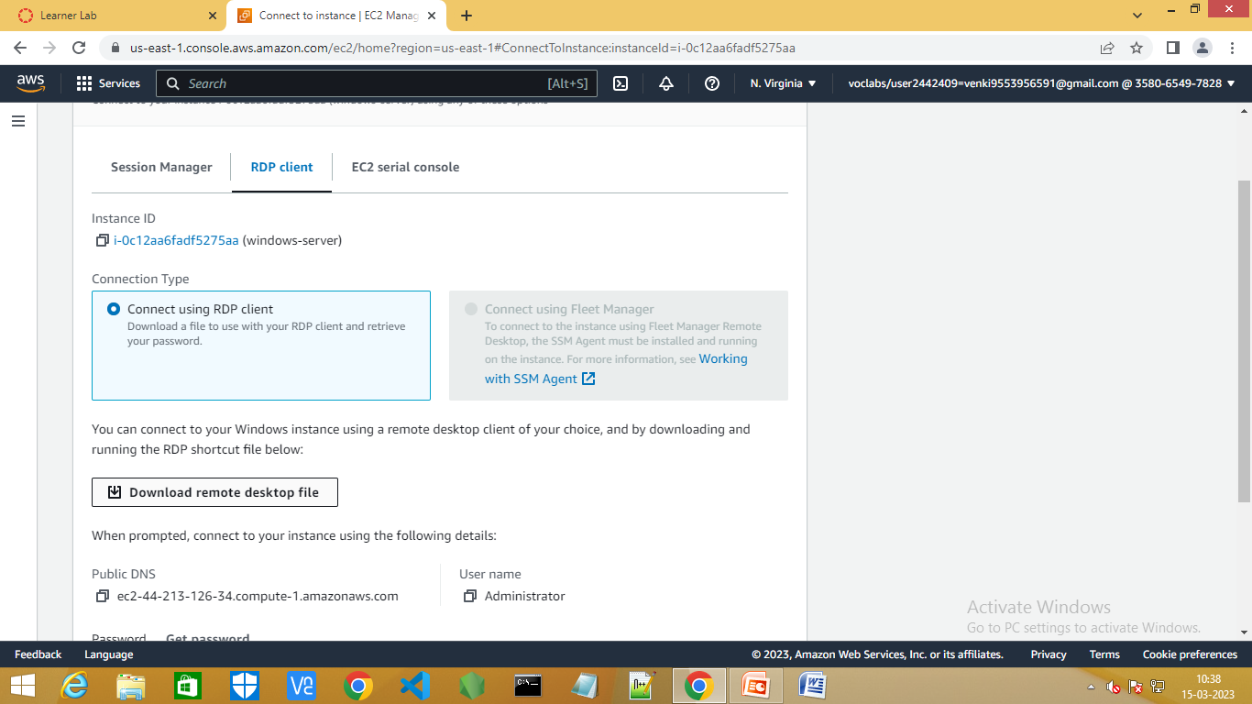
Step7:select RDP client and download remote desktop file.

Slide 9
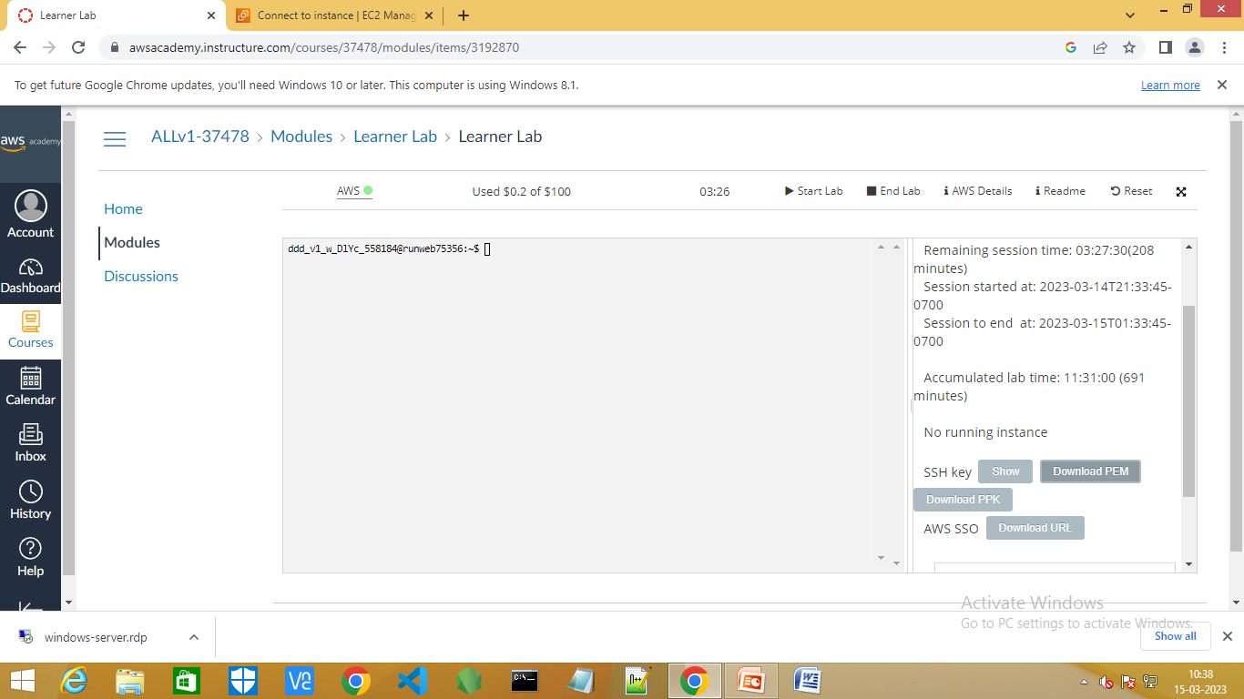
Step8:Now go to Learner Lab and Download PEM.

Slide 10
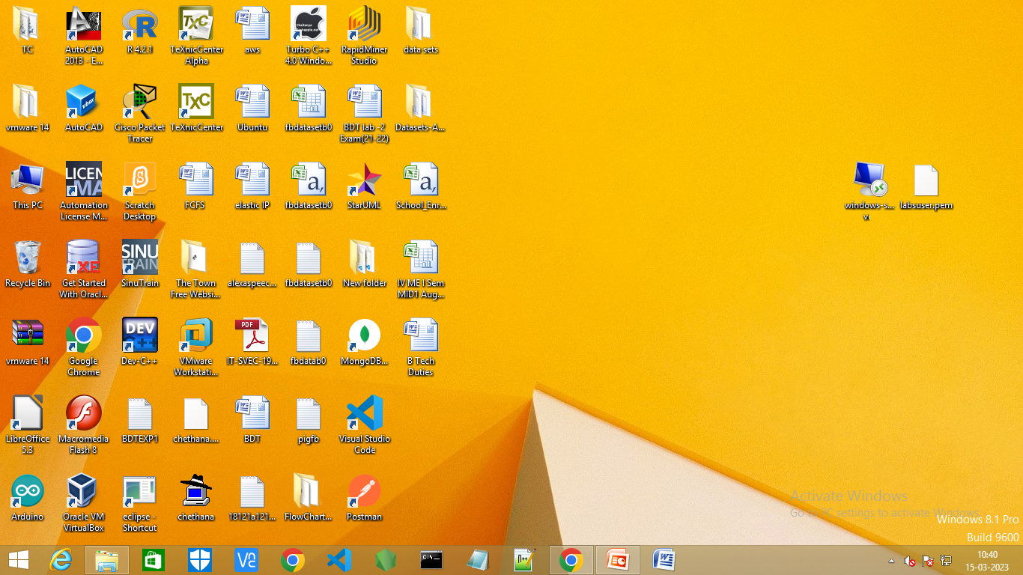
Step9:The desktop file and PEM file is seen on the desktop.

Slide 11
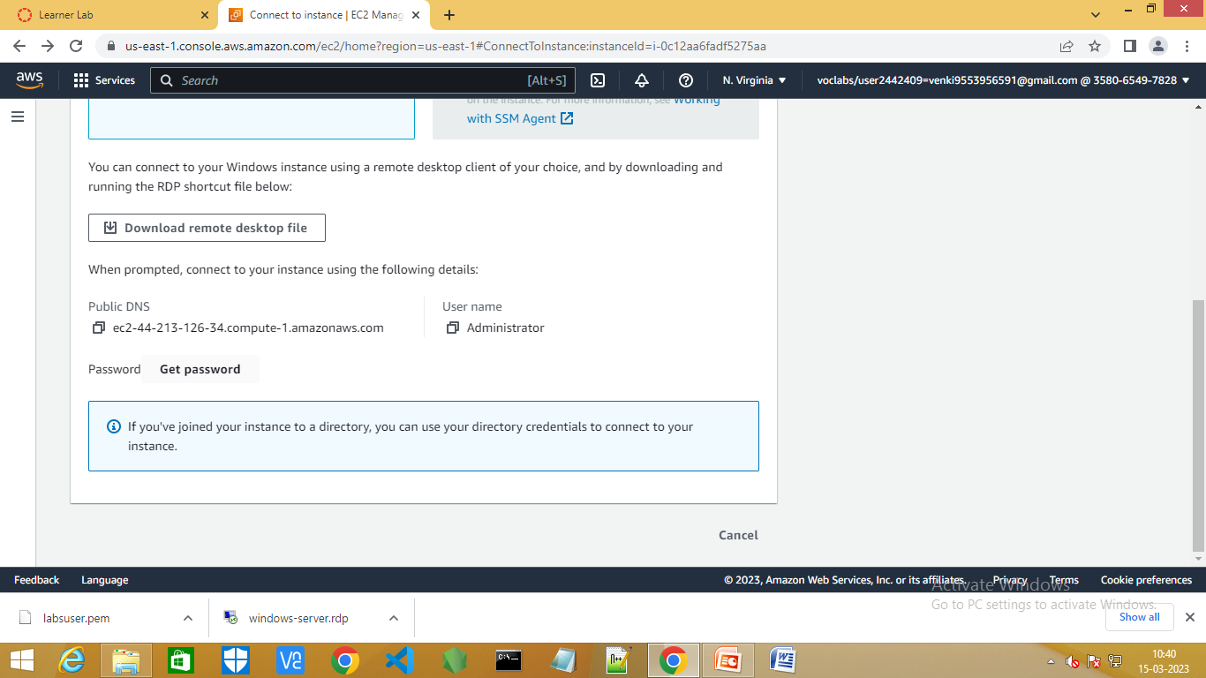
Step10:Now,go to the connect instance and select Get password.

Slide 12
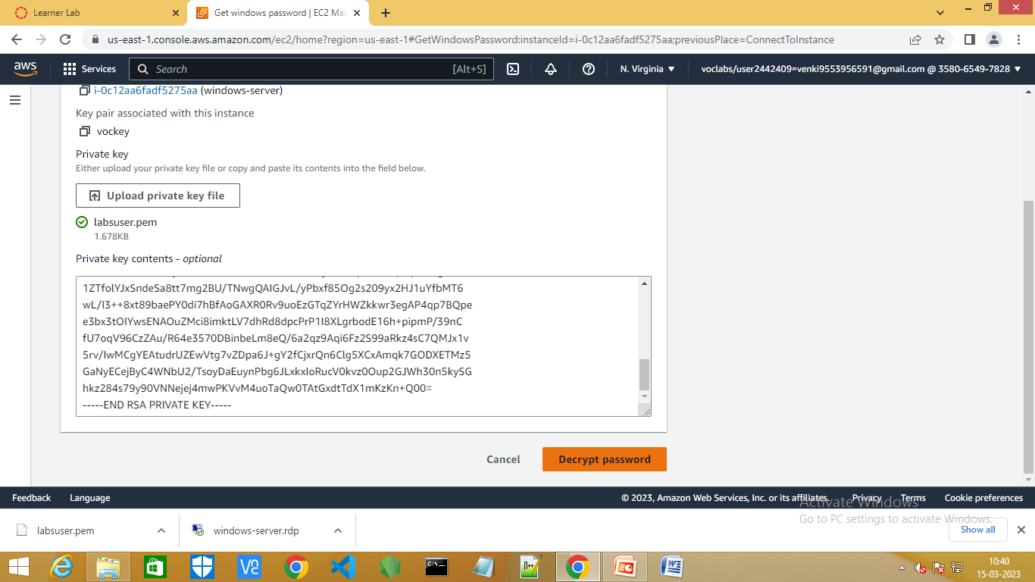
Step11:Upload the PEM file and select Decrypt password and copy the Password.

Slide 13
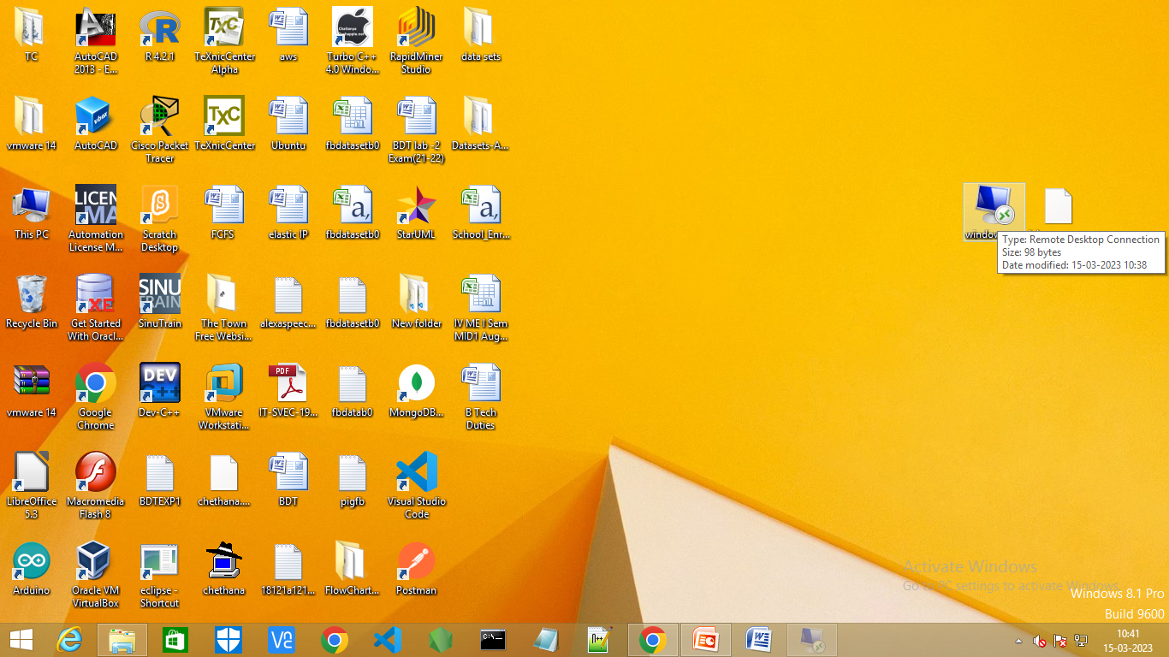
Step12:Now select the windows-server present on the desktop .

Slide 14
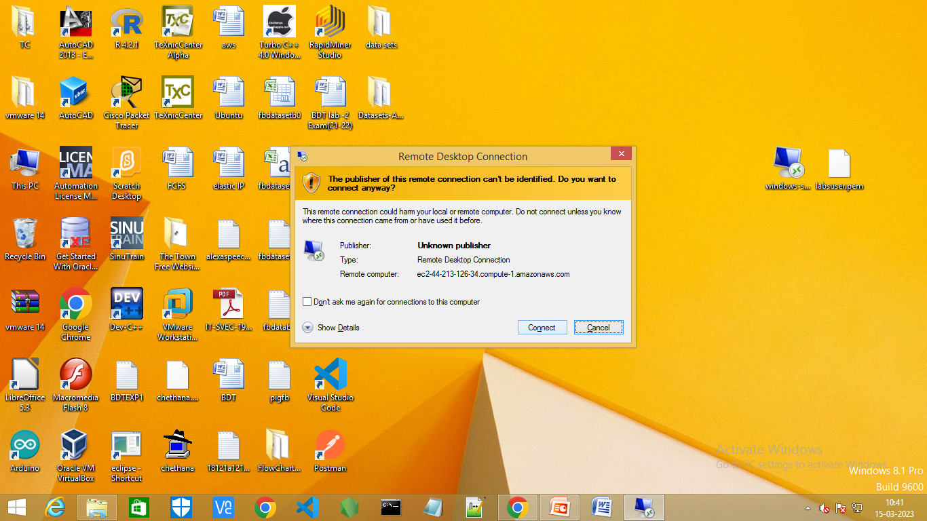
Step13:Click on connect.

Slide 15
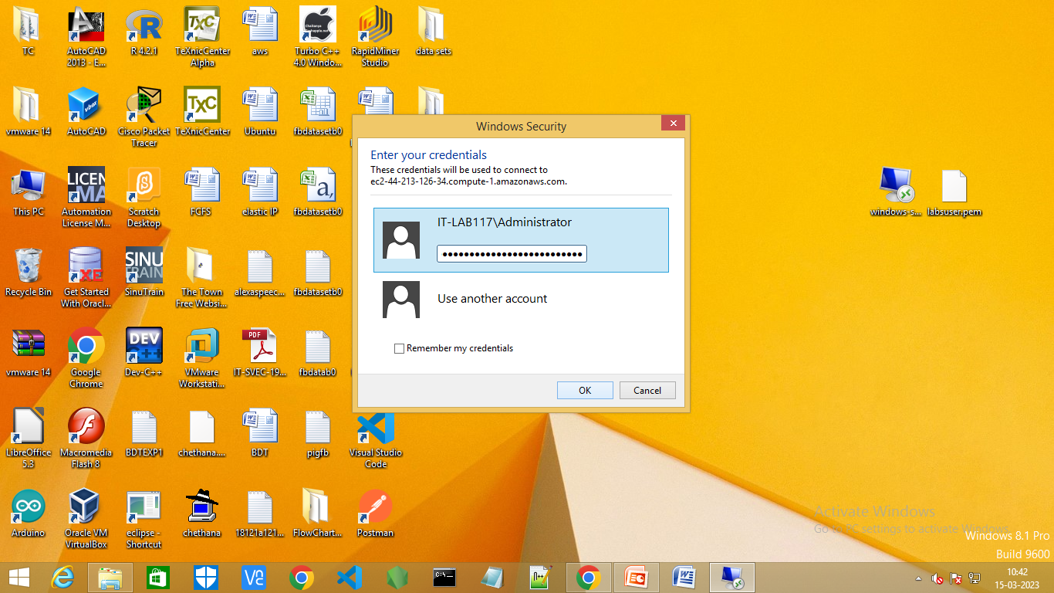
Step14:Give the saved password and click on ok.

Slide 16
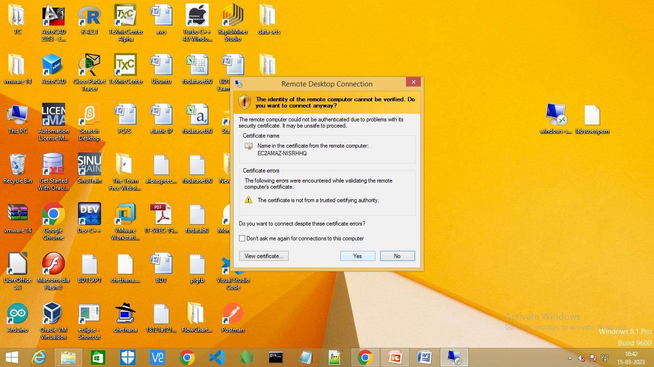
Step15:select yes.

Slide 17
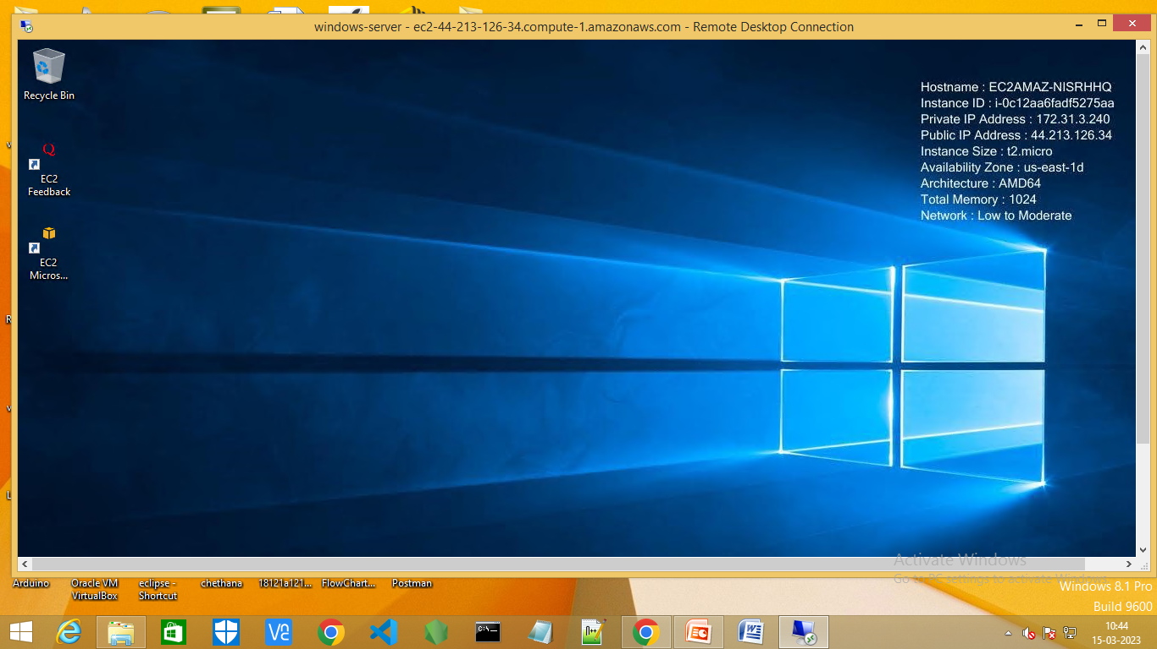
Step17:A new Remote Desktop is connected.

